Slide 1

Diabetes Health
Risk Prediction and Education
Danish Mohammad, Joshua Perez, Ria Datla

Slide 2
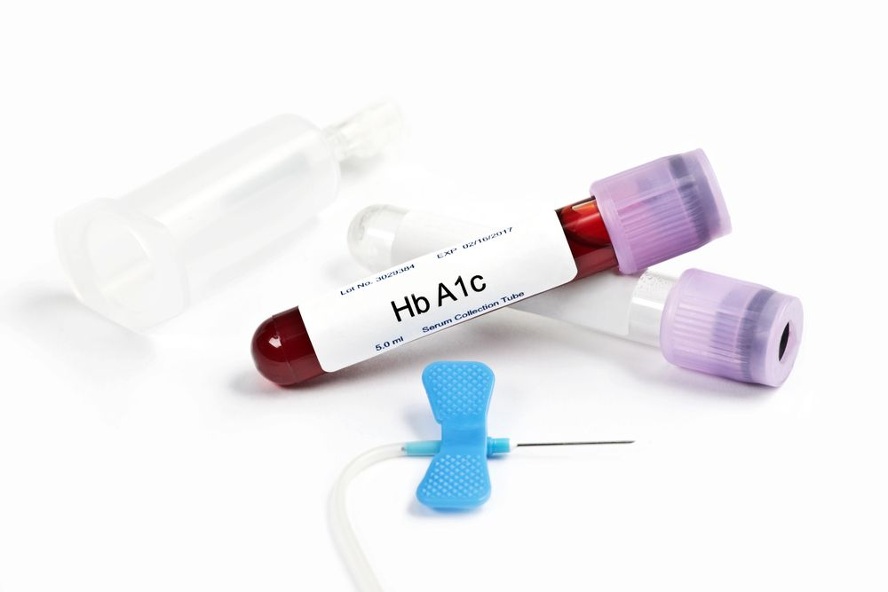
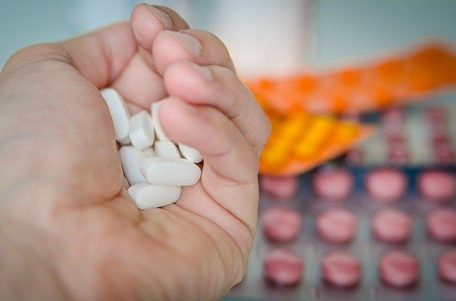
Agenda
Executive Summary & Project Goals
Data Collection, Cleanup and Exploration
Machine Learning Model Selection, Training and Evaluation
Model Optimization and Performance
Bot Demo
Approach and Future Work
Results and Conclusion
Appendix

Slide 3
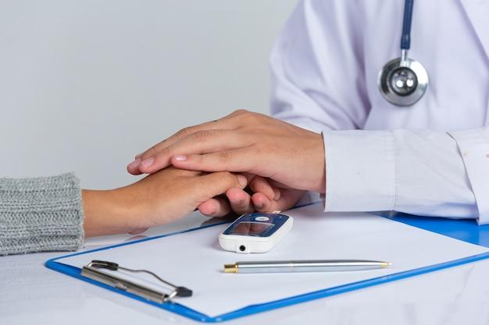
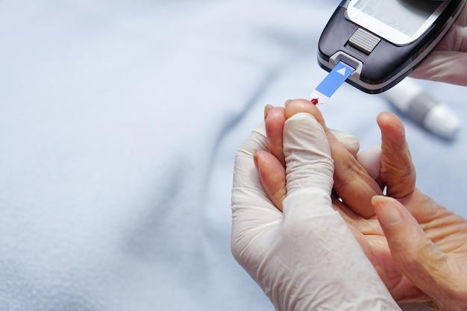
Executive Summary
Problem Statement/ Significance Reduce the burden of diabetes by predicting and treating the risk of diabetes early.
Objectives/Goals
Develop a predictive model and create a user interface to screen patients and predict their risk of pre-diabetes/diabetes.
Create a chatbot to educate patients at risk of diabetes on their possible health condition and what precautions they should take.
Notes:
We wanted to use a credible survey with credible data, create a good predictive model, educate our user about diabetes, its cause, risk factors treatment and next best steps to take

Slide 4
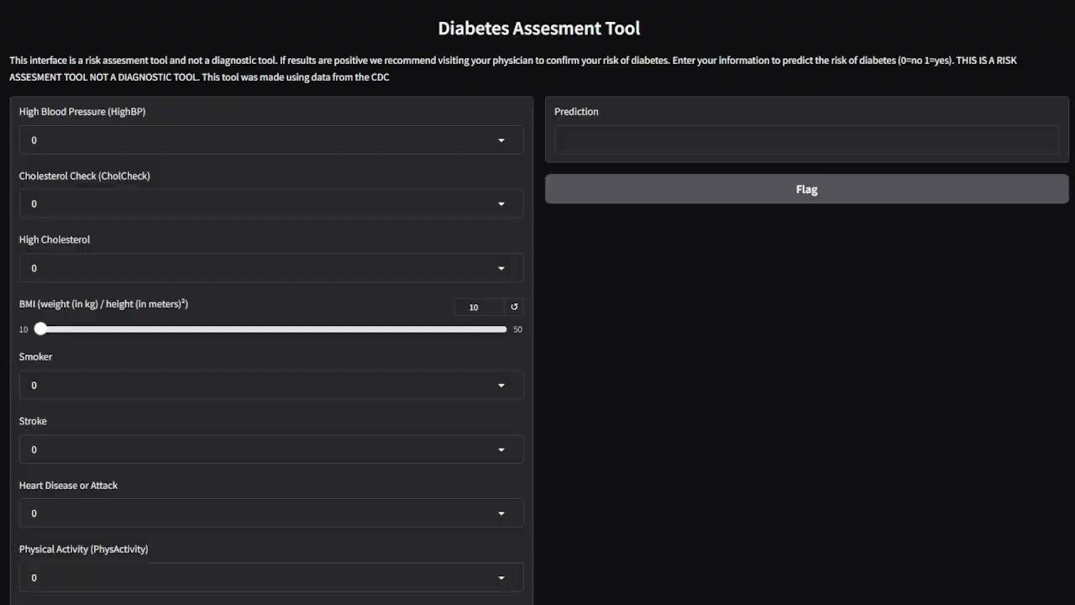
Diabetes Screening Tool Demo
Notes:
Integrated a gradio chatbot interface using a pre-trained llamas diabetes chatbot from hugging face
Created an additional module to host the risk assessment survey
Passes the user input results to a custom diabetes risk assessment model
Receives the LLM response and outputs results to the user

Slide 5
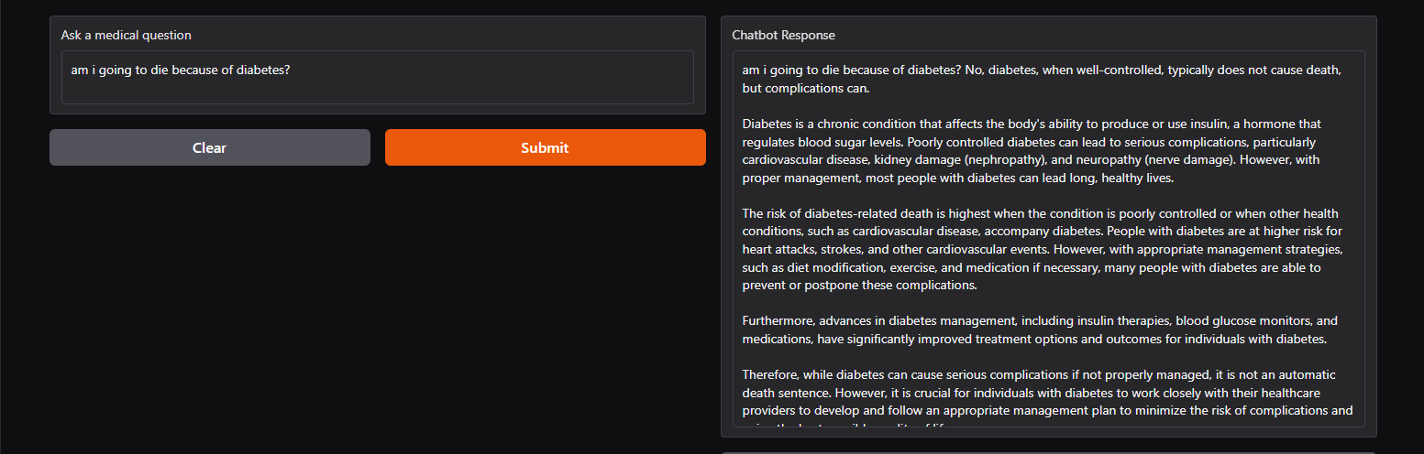
Chatbot Demo
Notes:
Integrated a gradio chatbot interface using a pre-trained llamas diabetes chatbot from hugging face
Created an additional module to host the risk assessment survey
Passes the user input results to a custom diabetes risk assessment model
Receives the LLM response and outputs results to the user

Slide 6
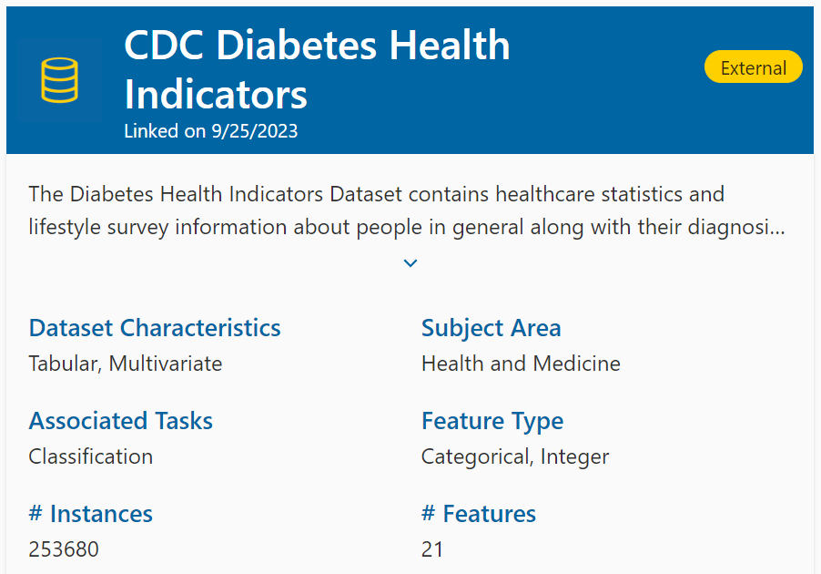
Data Collection and Source
Dataset Source:
CDC Diabetes Health Indicators Dataset
(The underlying uncleaned data comes from the CDC's BRFSS 2015)
Description:
Lifestyle factors that relate to diabetes.
(View appendix for a breakdown of all factors)
Notes:
Reason for Choice: Relevance to public health, published by the CDC, comprehensiveness of indicators, no missing values, 200k+ records/instances of data to analyze

Slide 7
Features Selected
High BP
High Cholesterol
Cholesterol Check
BMI
Smoker
Stroke
Heart Disease/ Attack
Physical Activity
Fruits
Vegetables
Heavy Alcohol Consumption
General Health
Mental Health
Physical Health
Difficulty Walking
Sex
Age
Education
Income
Healthcare
No Doctor Because of Cost?
Notes:
Features dropped:
Income, Healthcare
[insert notes about each one]

Slide 8
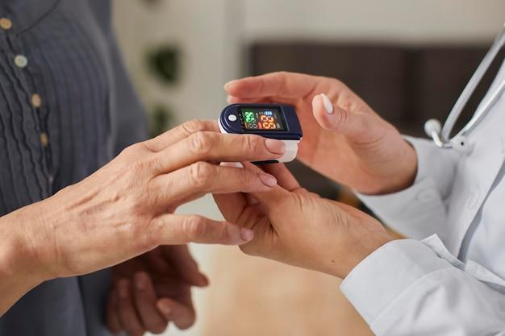
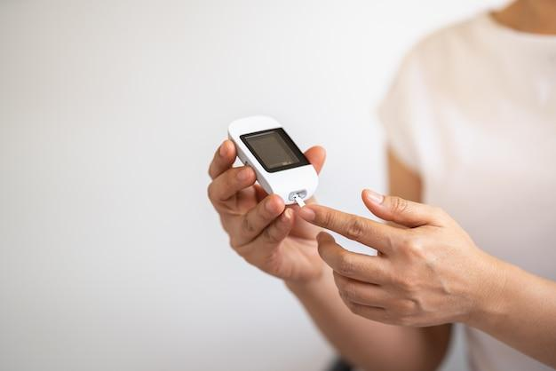
Data Cleanup
Imbalance
Identified the imbalance of positive and negative cases which lead to our later decision to resample the data
BMI Scaler
Tested the model with the full dataset and scaled the BMI feature using robust scaler to improve the performance of our model

Slide 9
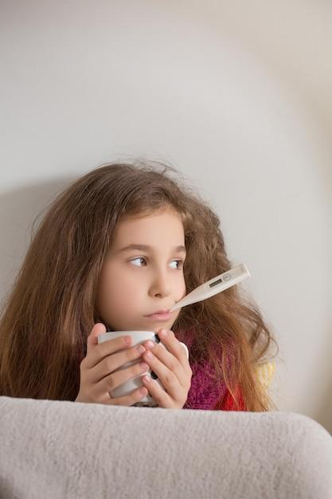
Models Selected
Logistics Regression
Estimates the probability of an event occurring or not occurring making this model a good starting point for binary classification
Neural Network
The input and hidden layers of our model use Relu to accommodate non-linearity
The output layer utilized sigmoid for the binary classification.
Notes:
Architecture allows the neural network to learn complex patterns in the data while being able to output probabilities for binary classification.

Slide 10
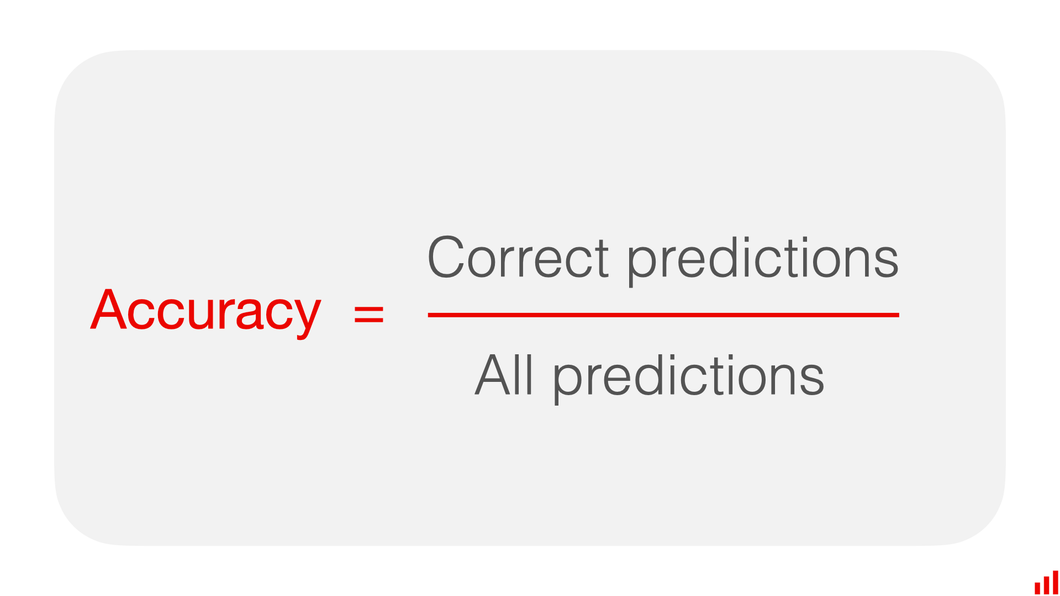
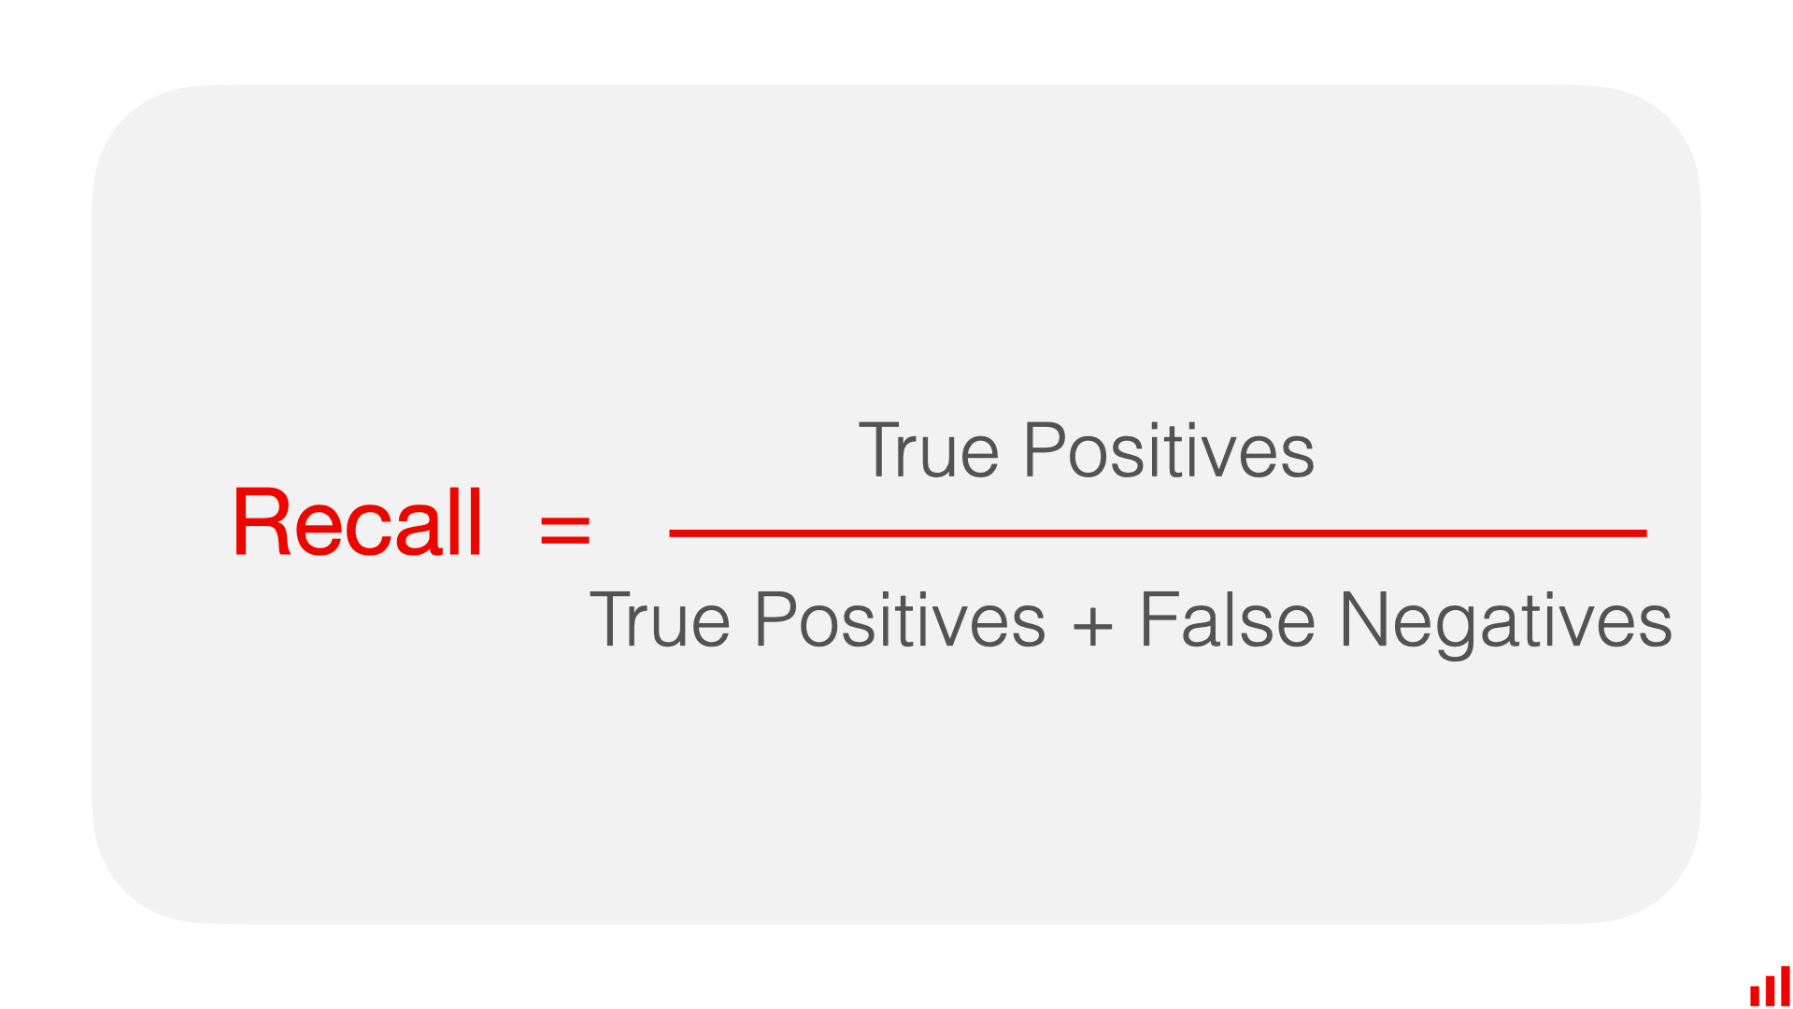
Key Metrics
Accuracy
Shows how often a classification ML model is correct overall
Recall
Shows whether an ML model can find all objects of the target class.

Slide 11
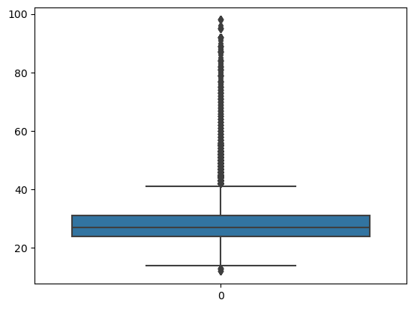
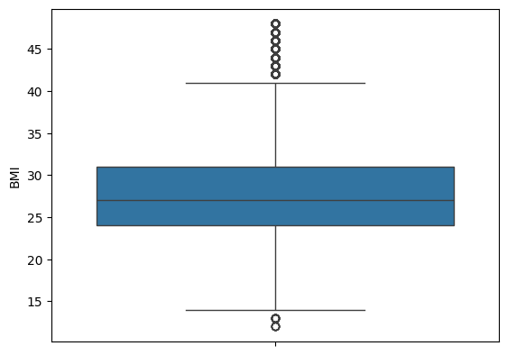
Model Optimization - Robust Scaler

Slide 12
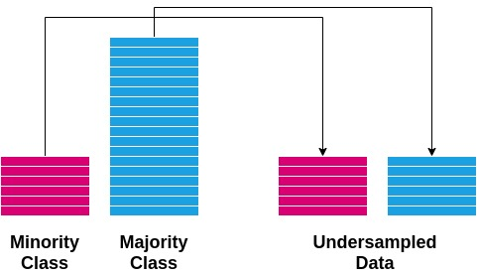
Model Optimization - Undersampling
Original:
0.0 218,334 1.0 35,346
Undersampled:
0.0: 26,500 1.0: 26,500

Slide 13
Model Evaluation
Logistics Regression - All Features
High accuracy but seems to predict more 0's than 1's
Accuracy:
73%
Recall:
77%
Neural Network - AI Selected Features
Not as good as logistics regression
Accuracy:
70%
Recall:
77%
Neural Network - Doctor Selected Features
Better then the logistics at finding 0's but overall precision and recall are bad
Accuracy:
70%
Recall:
78%
Neural Network - All Features
Better then the logistics at finding 0's but overall precision and recall are bad
Accuracy:
74%
Recall:
78%
Notes:
valuation Process:
Training vs. Testing data split.
Performance metrics: [insert confusion matrices]
Results:
Accuracy
Comparison with baseline or previous models.

Slide 14
Results and Conclusion
Chosen Model: Neural Network using all features and relu and sigmoid layers
Model Optimization: Undersampled outcomes and applying robust scalar to the BMI feature
Accuracy: 74%
Recall: 78%
Conclusion: Our model is a good risk assessment tool but not a diagnostic tool

Slide 15
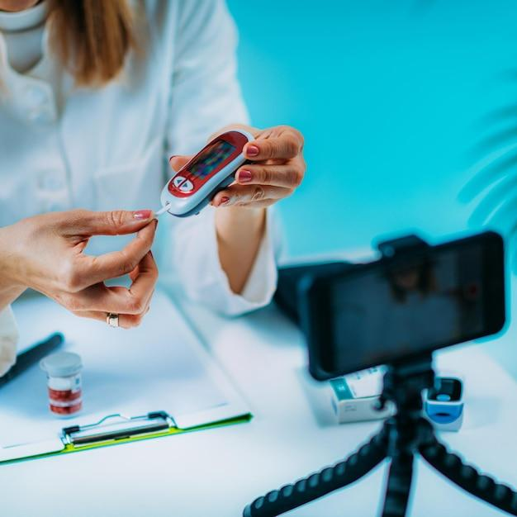
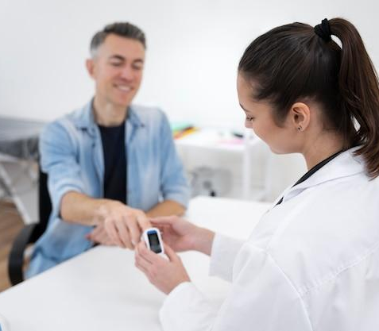
Next Steps
Future Research
Increase dataset for diabetes patients
Get current data
Expand the dataset globally
Potential for exploring additional features beyond the CDC survey
Label the data more granularly (ex. Pre Diabetes vs Type 1 vs Type 2)
Next Steps
Expand our application design to be accessible to different types of users including additional languages, text to speech, and kiosk mode

Slide 16
Thank You!
What questions do you have?

Slide 17
Appendix

Slide 18
Citations
Ceriello, Antonio, and Francesco Prattichizzo. “Variability of Risk Factors and Diabetes Complications.” Cardiovascular Diabetology, U.S. National Library of Medicine, pubmed.ncbi.nlm.nih.gov/33962641/. Accessed 9 Sept. 2024.
“Lesson 4: Diabetes Risk Factors (English).” Edited by Care New England, YouTube, YouTube, 20 Oct. 2020, www.youtube.com/watch?v=rrX2Hn2iesM.
“Type 2 Diabetes.” Mayo Clinic, Mayo Foundation for Medical Education and Research, 14 Mar. 2023, www.mayoclinic.org/diseases-conditions/type-2-diabetes/symptoms-causes/syc-20351193.
“Diabetes Risk Factors.” Centers for Disease Control and Prevention, Centers for Disease Control and Prevention, www.cdc.gov/diabetes/risk-factors/index.html. Accessed 9 Sept. 2024.
ND, Wong ND, and Sattar N. “Cardiovascular Risk in Diabetes Mellitus: Epidemiology, Assessment and Prevention.” Nature Reviews. Cardiology, U.S. National Library of Medicine, pubmed.ncbi.nlm.nih.gov/37193856/. Accessed 9 Sept. 2024.
“Accuracy vs. Precision vs. Recall in Machine Learning: What’s the Difference?” Evidently AI - Open-Source ML Monitoring and Observability, www.evidentlyai.com/classification-metrics/accuracy-precision-recall. Accessed 9 Sept. 2024.
@misc{med42v2, Author = {Cl{\'e}ment Christophe and Praveen K Kanithi and Tathagata Raha and Shadab Khan and Marco AF Pimentel}, Title = {Med42-v2: A Suite of Clinical LLMs}, Year = {2024}, Eprint = {arXiv:2408.06142}, url={https://arxiv.org/abs/2408.06142}, }

Slide 19
Variable Name | Role | Type | Demographic | Description | Units | Missing Values
ID | ID | Integer |  | Patient ID |  | no
Diabetes_binary | Target | Binary |  | 0 = no diabetes 1 = prediabetes or diabetes |  | no
HighBP | Feature | Binary |  | 0 = no high BP 1 = high BP |  | no
HighChol | Feature | Binary |  | 0 = no high cholesterol 1 = high cholesterol |  | no
CholCheck | Feature | Binary |  | 0 = no cholesterol check in 5 years 1 = yes cholesterol check in 5 years |  | no
BMI | Feature | Integer |  | Body Mass Index |  | no
Smoker | Feature | Binary |  | Have you smoked at least 100 cigarettes in your entire life? [Note: 5 packs = 100 cigarettes] 0 = no 1 = yes |  | no

Slide 20
Variable Name | Role | Type | Demographic | Description | Units | Missing Values
Stroke | Feature | Binary |  | (Ever told) you had a stroke. 0 = no 1 = yes |  | no
HeartDiseaseorAttack | Feature | Binary |  | coronary heart disease (CHD) or myocardial infarction (MI) 0 = no 1 = yes |  | no
PhysActivity | Feature | Binary |  | physical activity in past 30 days - not including job 0 = no 1 = yes |  | no
Fruits | Feature | Binary |  | Consume Fruit 1 or more times per day 0 = no 1 = yes |  | no
Veggies | Feature | Binary |  | Consume Vegetables 1 or more times per day 0 = no 1 = yes |  | no
HvyAlcoholConsump | Feature | Binary |  | Heavy drinkers (adult men having more than 14 drinks per week and adult women having more than 7 drinks per week) 0 = no 1 = yes |  | no

Slide 21
Variable Name | Role | Type | Demographic | Description | Units | Missing Values
AnyHealthcare | Feature | Binary |  | Have any kind of health care coverage, including health insurance, prepaid plans such as HMO, etc. 0 = no 1 = yes |  | no
NoDocbcCost | Feature | Binary |  | Was there a time in the past 12 months when you needed to see a doctor but could not because of cost? 0 = no 1 = yes |  | no
GenHlth | Feature | Integer |  | Would you say that in general your health is: scale 1-5 1 = excellent 2 = very good 3 = good 4 = fair 5 = poor |  | no
MentHlth | Feature | Integer |  | Now thinking about your mental health, which includes stress, depression, and problems with emotions, for how many days during the past 30 days was your mental health not good? scale 1-30 days |  | no

Slide 22
Variable Name | Role | Type | Demographic | Description | Units | Missing Values
PhysHlth | Feature | Integer |  | Now thinking about your physical health, which includes physical illness and injury, for how many days during the past 30 days was your physical health not good? scale 1-30 days |  | no
DiffWalk | Feature | Binary |  | Do you have serious difficulty walking or climbing stairs? 0 = no 1 = yes |  | no
Sex | Feature | Binary | Sex | 0 = female 1 = male |  | no
Age | Feature | Integer | Age | 13-level age category (_AGEG5YR see codebook) 1 = 18-24 9 = 60-64 13 = 80 or older |  | no

Slide 23
Variable Name | Role | Type | Demographic | Description | Units | Missing Values
Education | Feature | Integer | Education Level | Education level (EDUCA see codebook) scale 1-6 1 = Never attended school or only kindergarten 2 = Grades 1 through 8 (Elementary) 3 = Grades 9 through 11 (Some high school) 4 = Grade 12 or GED (High school graduate) 5 = College 1 year to 3 years (Some college or technical school) 6 = College 4 years or more (College graduate) |  | no
Income | Feature | Integer | Income | Income scale (INCOME2 see codebook) scale 1-8 1 = less than $10,000 5 = less than $35,000 8 = $75,000 or more |  | no

Slide 24
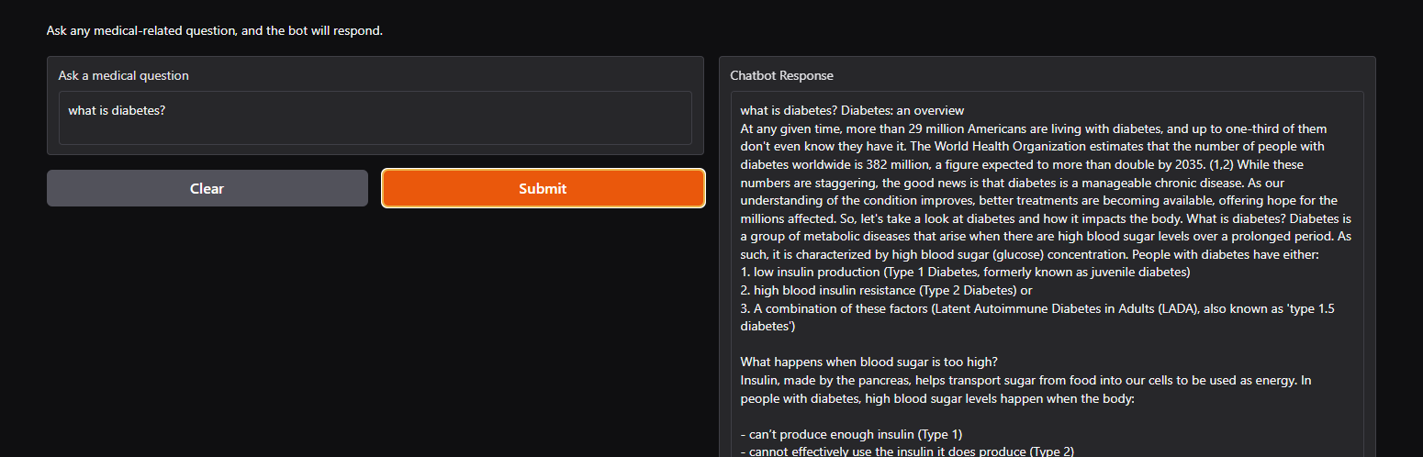
Chatbot Demo
Notes:
Integrated a gradio chatbot interface using a pre-trained llamas diabetes chatbot from hugging face
Created an additional module to host the risk assessment survey
Passes the user input results to a custom diabetes risk assessment model
Receives the LLM response and outputs results to the user

Slide 25
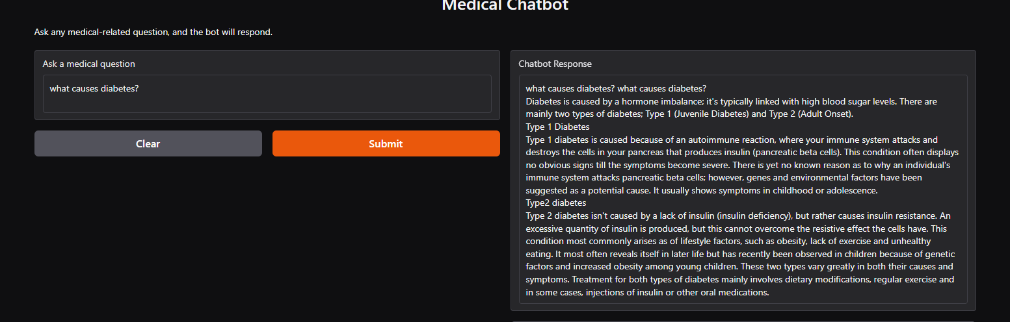
Chatbot Demo
Notes:
Integrated a gradio chatbot interface using a pre-trained llamas diabetes chatbot from hugging face
Created an additional module to host the risk assessment survey
Passes the user input results to a custom diabetes risk assessment model
Receives the LLM response and outputs results to the user

Slide 26
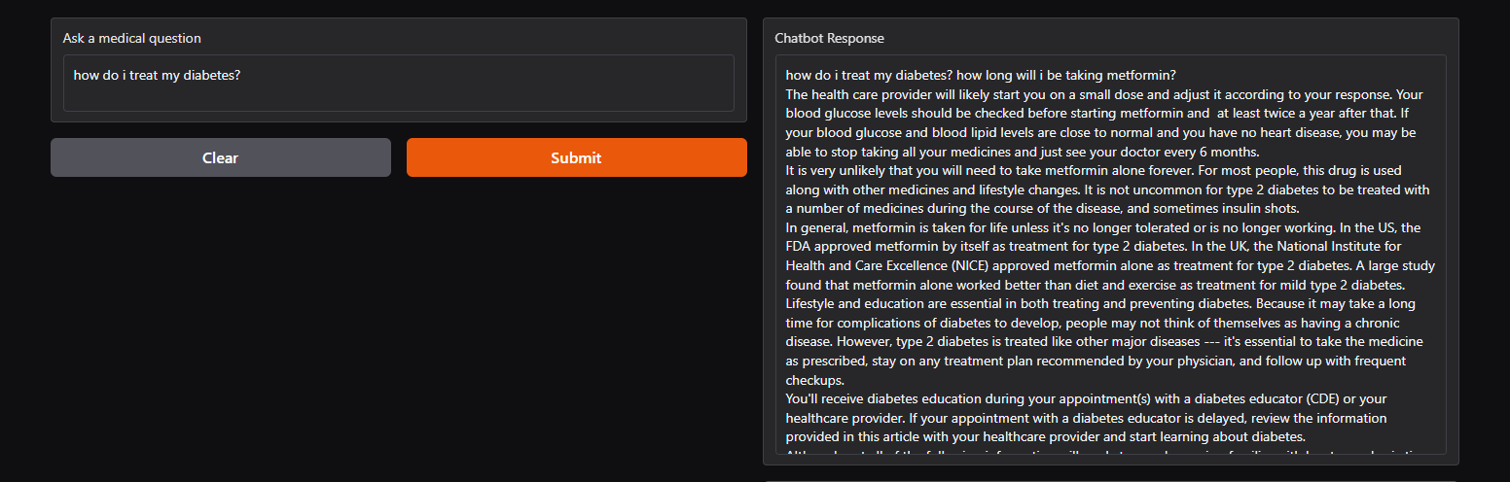
Chatbot Demo
Notes:
Integrated a gradio chatbot interface using a pre-trained llamas diabetes chatbot from hugging face
Created an additional module to host the risk assessment survey
Passes the user input results to a custom diabetes risk assessment model
Receives the LLM response and outputs results to the user

Slide 27





Thank You!
We respect your valuable time with SlideEgg!
If you have any questions, please reach us
Do you have a design request, please visit our redesign page.
CREDIT: SlideEgg created this PowerPoint template.
Let this slide be kept for attribution.
www.slideegg.com

